Slide 1

Tuwaiq Electronics
Group 1
Eyad Adnan Makkawi-444003279
Enad Abdulmohsen Alharbi-444002681
Jawad Ayman Alharbi-444004266
Jawad Khalid Alotaibi-444003256
Turki Abdullah Alotaibi-444002785

Slide 2
About Tuwaiq Electronics
Here at Tuwaiq Electronics, we are passionate about sell electronics with the best prices, and providing monthly sales. We strive to provide our customers with our high-quality products and our slogan is "Buy With Confidence".

Slide 3
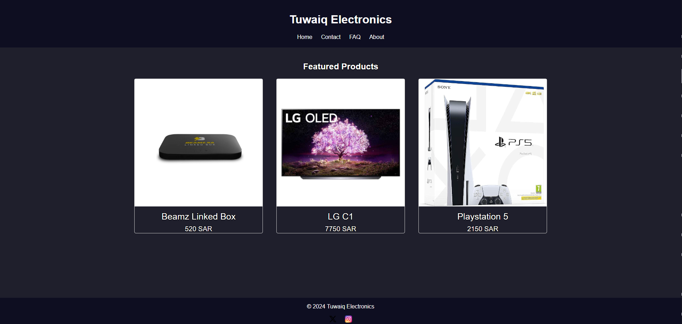
Home page

Slide 4
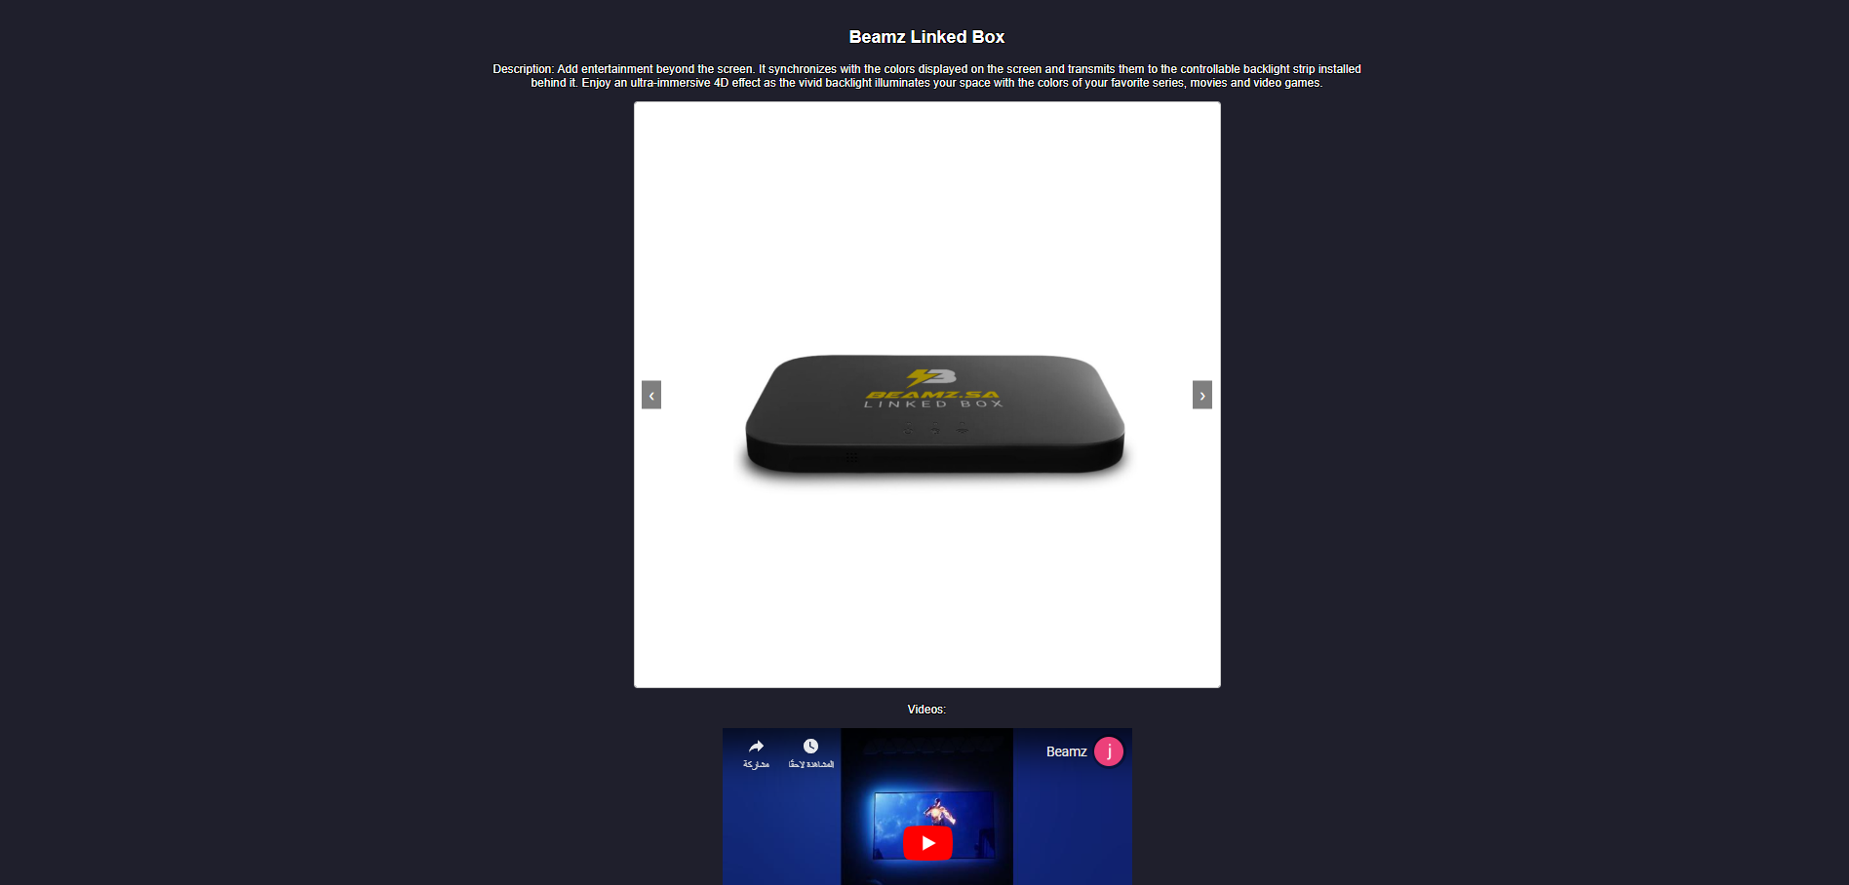
products page (beamz Linked box)

Slide 5
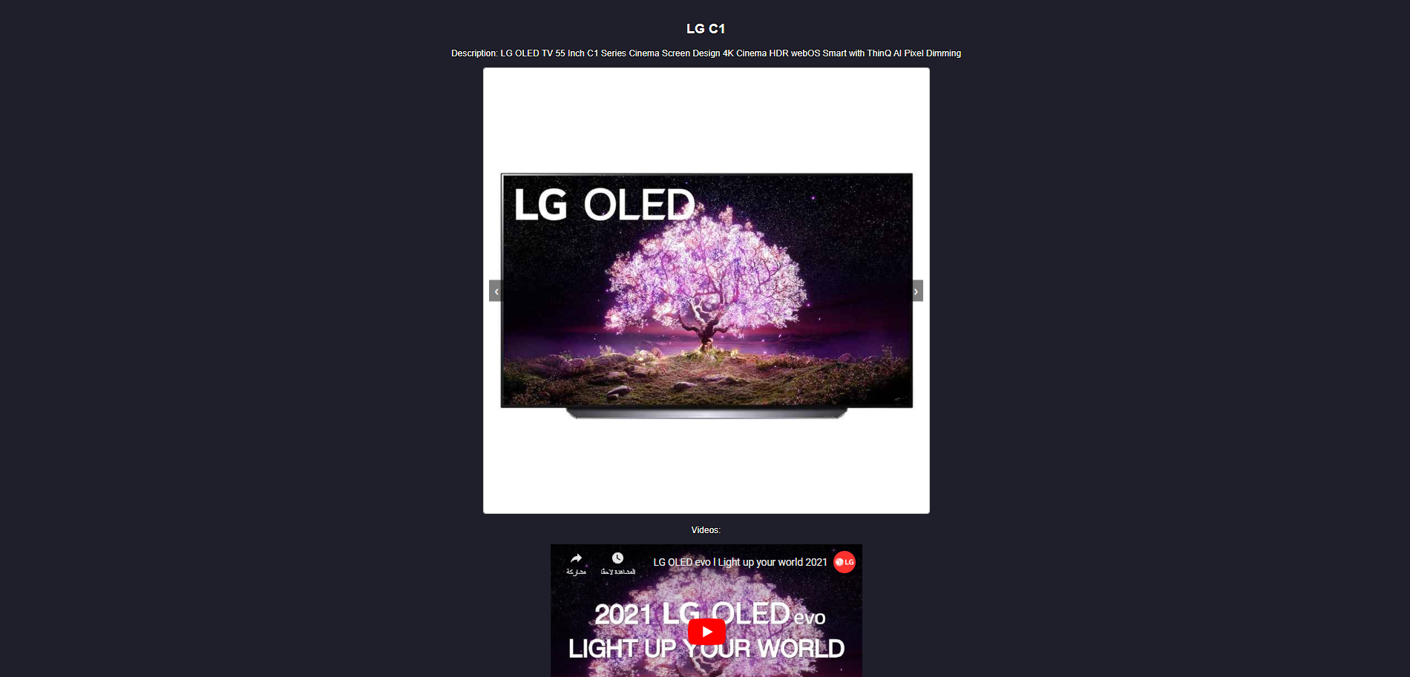
products page (LG C1)

Slide 6
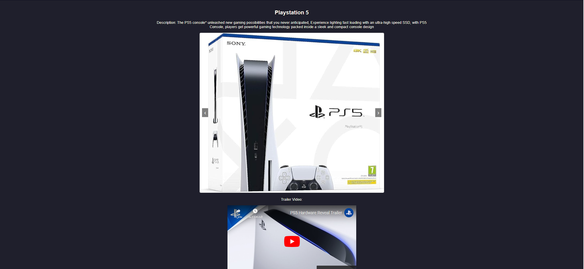
products page (Playstation 5)

Slide 7

Contact page

Slide 8

Display page

Slide 9
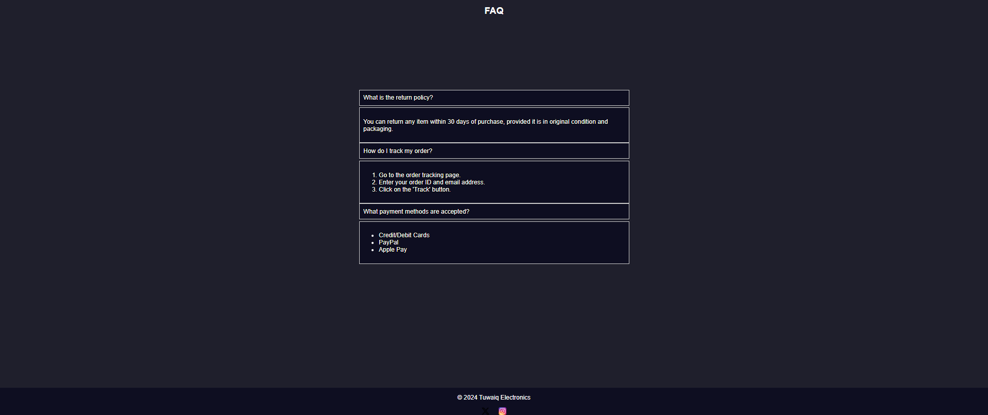
FAQ page

Slide 10
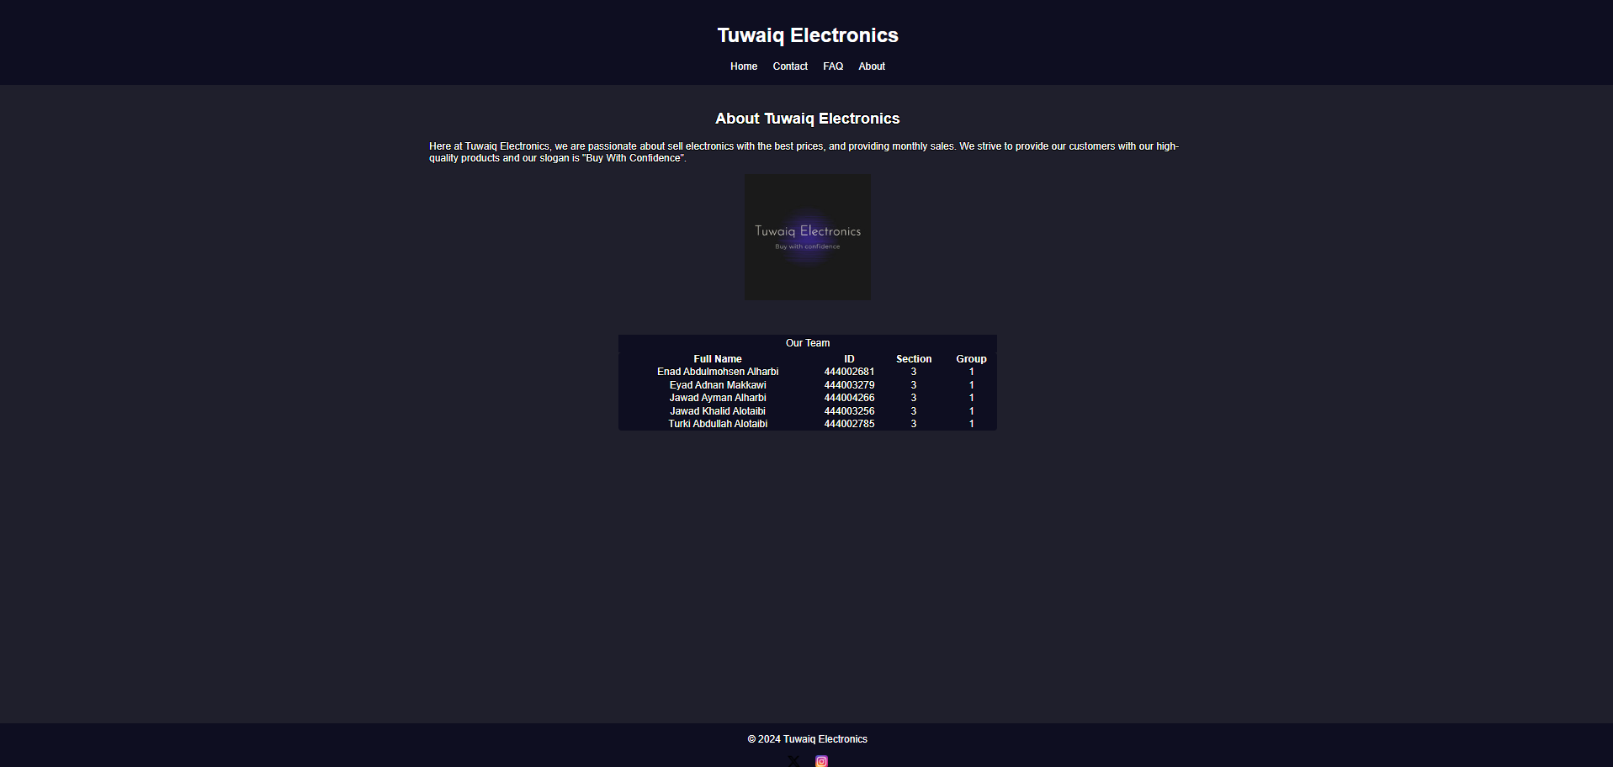
about page

Slide 11
Thank you for watching

